Slide 1
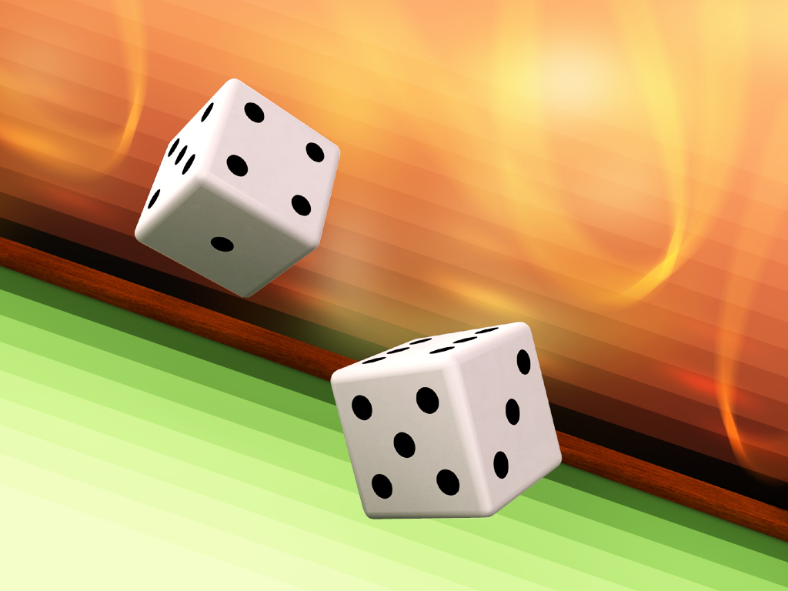
Application Programming Final Project: Casino Craps

Slide 2
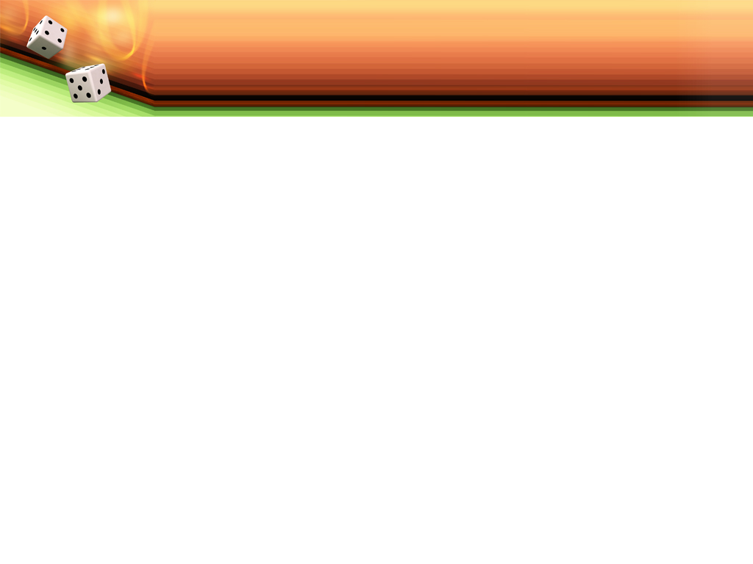
Team Members
Team Leader: Carly Joe Almanza
Jaden Dickerson
Marcus Stokes
Tharun Karakkatt
Roberto Rodriguez-Delgado

Slide 3
Overview
Project Description/Pitch
Project Demo
Code Explanation
Summary

Slide 4
Project Description
How the game works: The concept of playing craps is to roll a number with two dice and then roll that same number again before a seven is rolled. If a seven is rolled the player loses and has the option to bet again.
Pitch: Our application of a casino game “craps”, is meant to simulate an actually tabletop game where users can have fun while also getting a chance to learn how to place bets/ gamble with no real life penalty. It's a great way to learn a new game and test your luck at the same time, what are the odds.

Slide 5

Project Demo

Slide 6
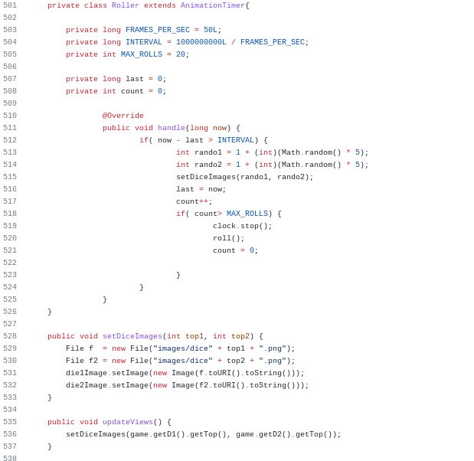
Project Code Explanation

Slide 7
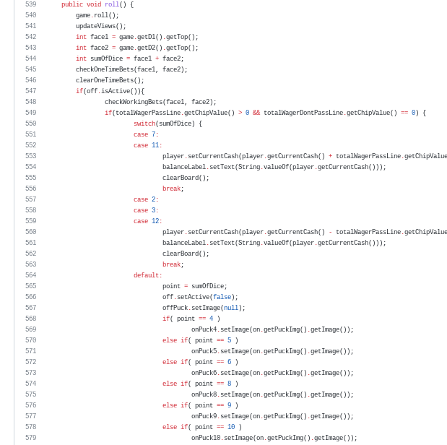
Project Code Explanation

Slide 8
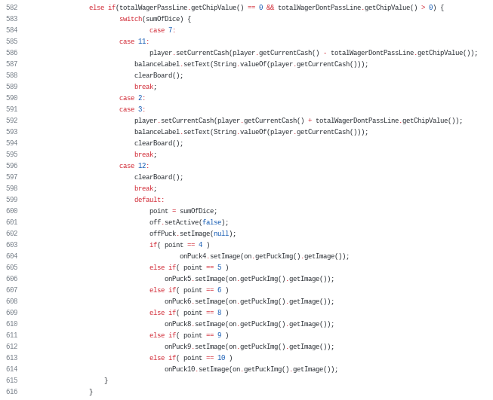
Project Code Explanation

Slide 9
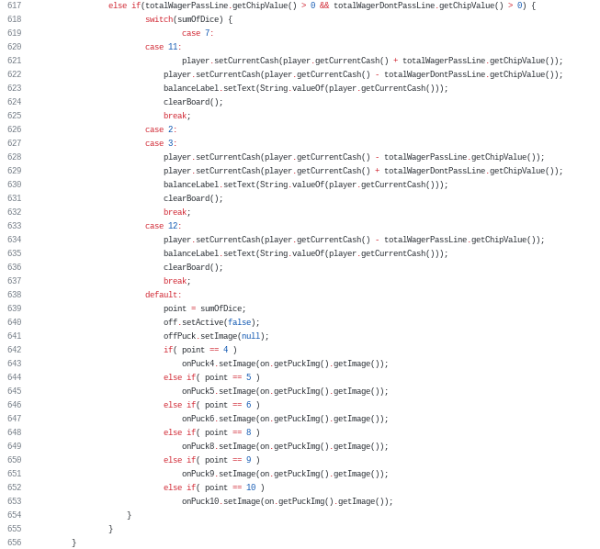
Project Code Explanation

Slide 10
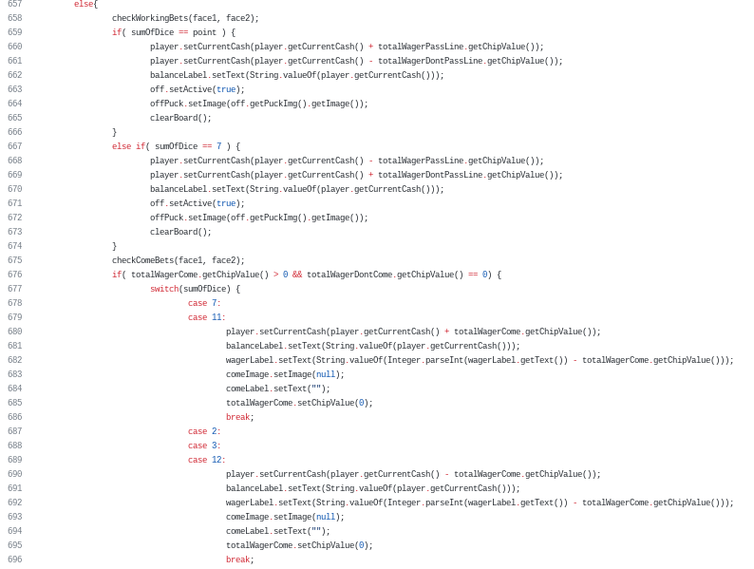
Project Code Explanation

Slide 11
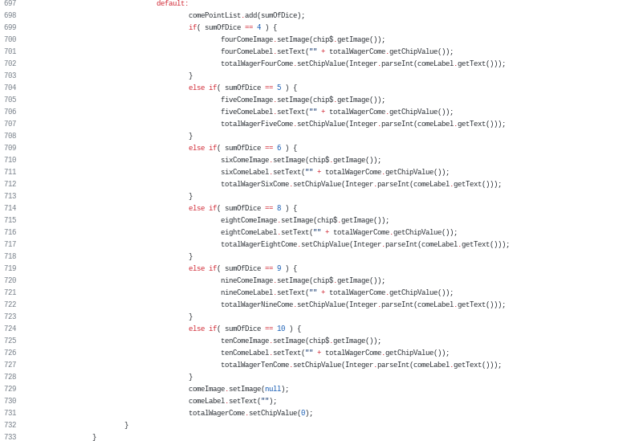
Project Code Explanation

Slide 12
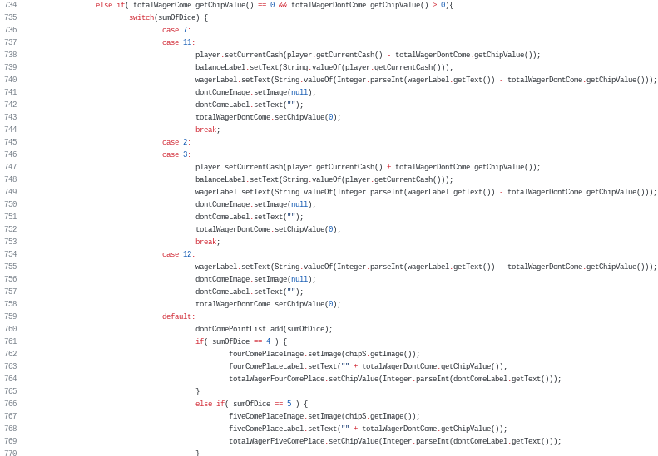
Project Code Explanation

Slide 13
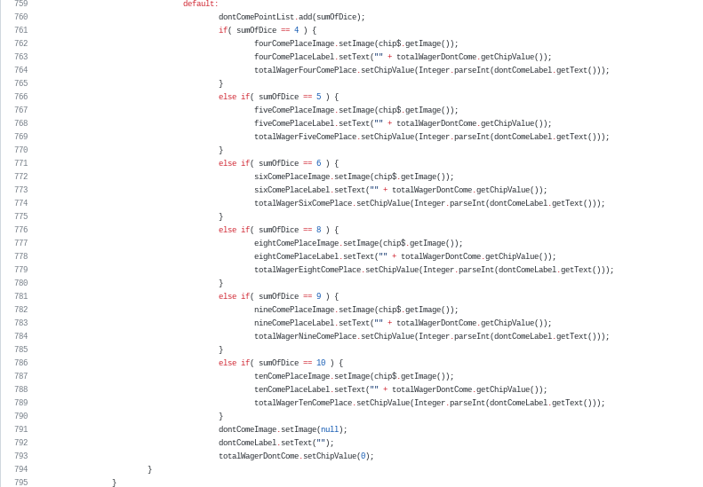
Project Code Explanation

Slide 14
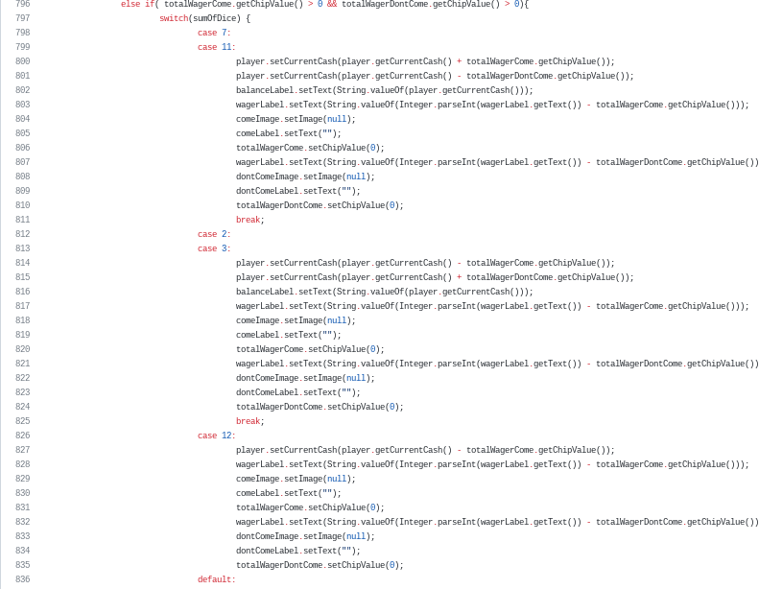
Project Code Explanation

Slide 15
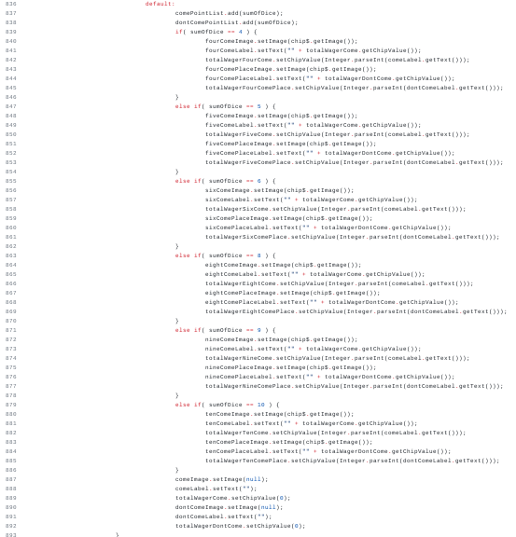
Project Code Explanation

Slide 16

Project Code Explanation

Slide 17
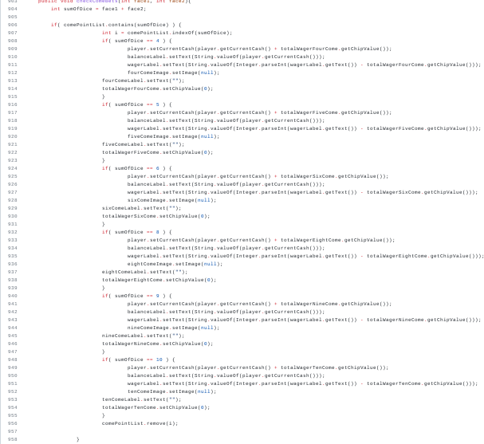
Project Code Explanation

Slide 18
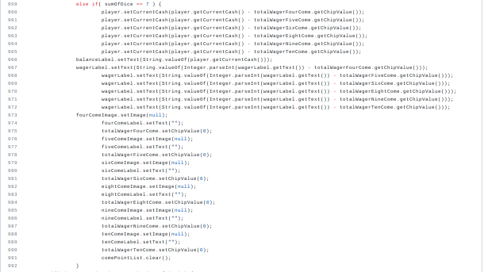
Project Code Explanation

Slide 19
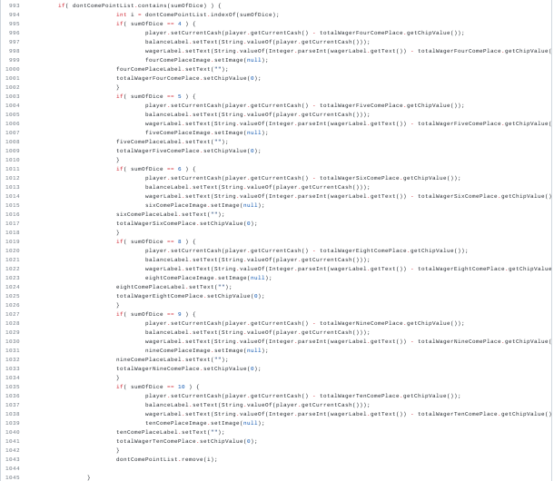
Project Code Explanation

Slide 20
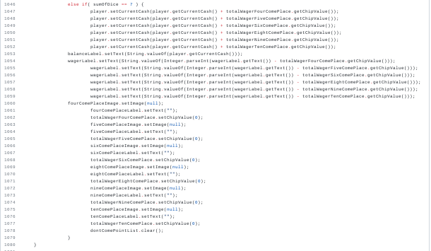
Project Code Explanation

Slide 21
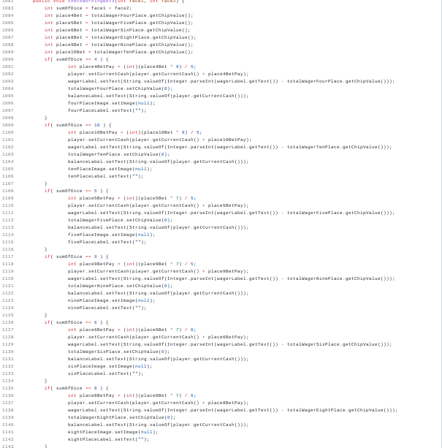
Project Code Explanation

Slide 22
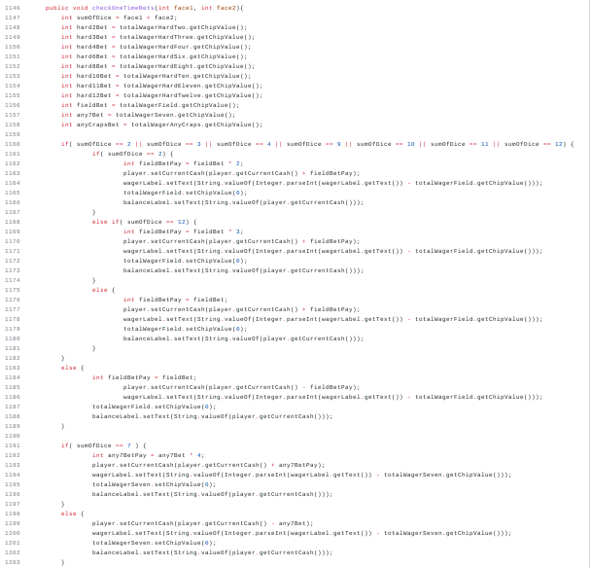
Project Code Explanation

Slide 23
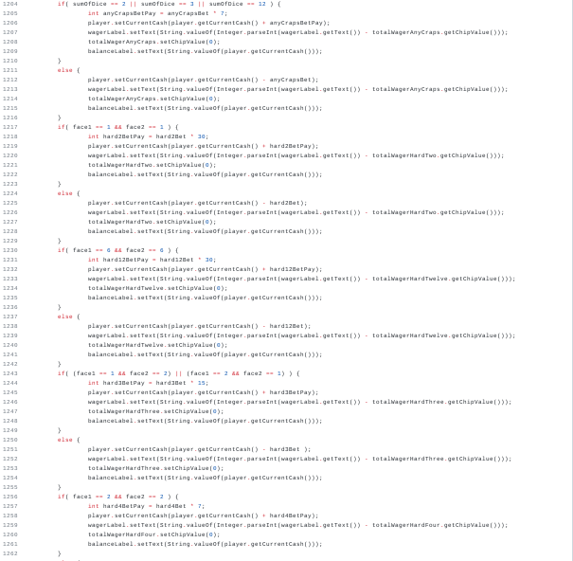
Project Code Explanation

Slide 24
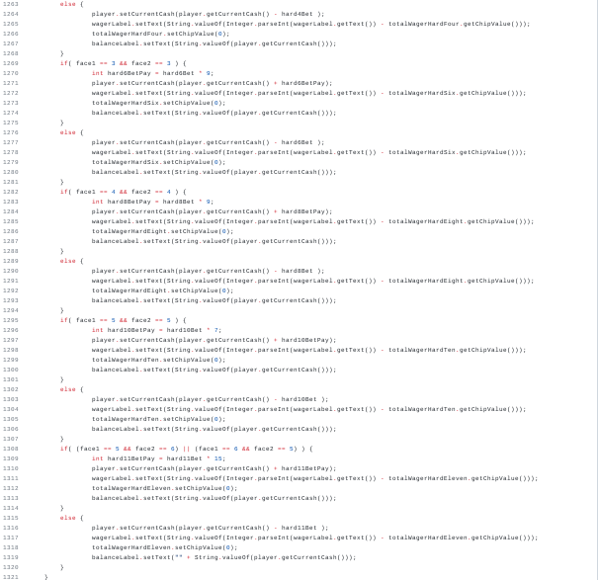
Project Code Explanation

Slide 25
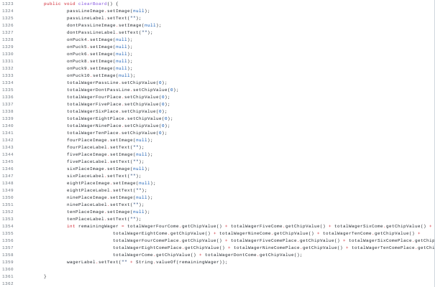
Project Code Explanation

Slide 26
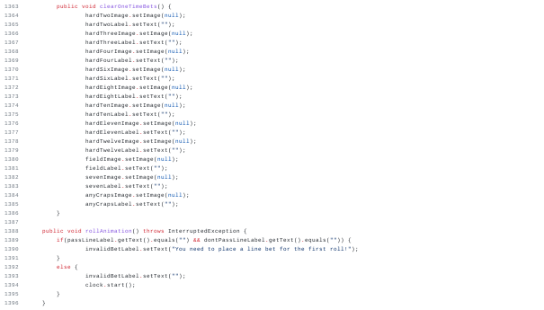
Project Code Explanation

Slide 27
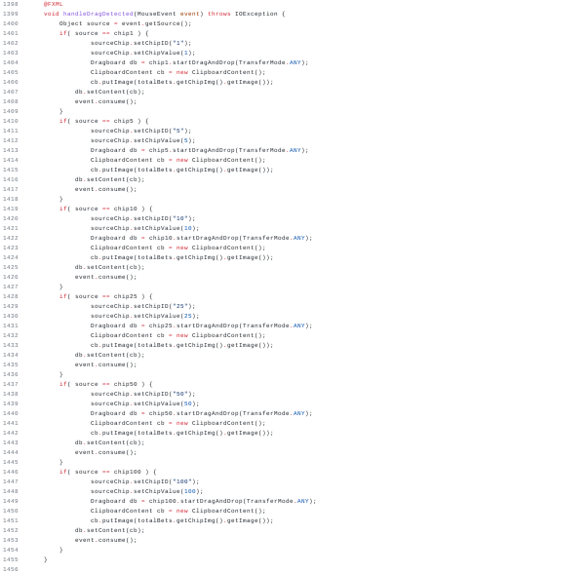
Project Code Explanation

Slide 28
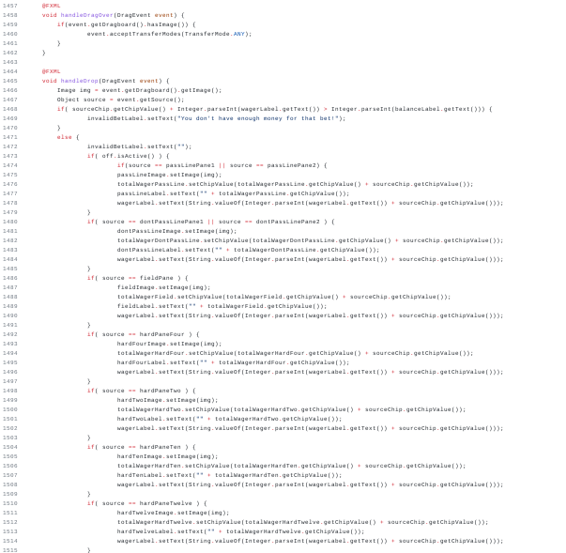
Project Code Explanation

Slide 29
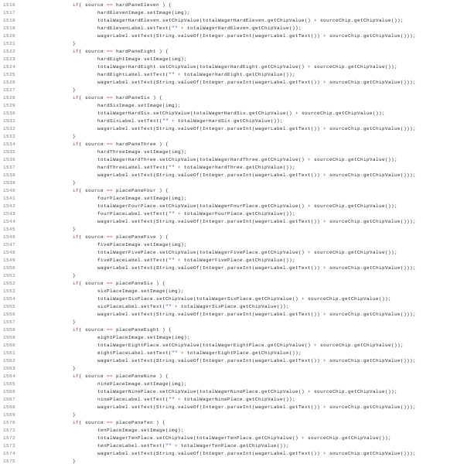
Project Code Explanation

Slide 30
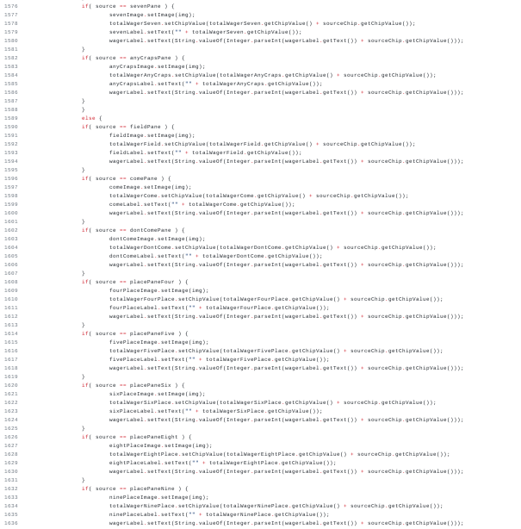
Project Code Explanation

Slide 31
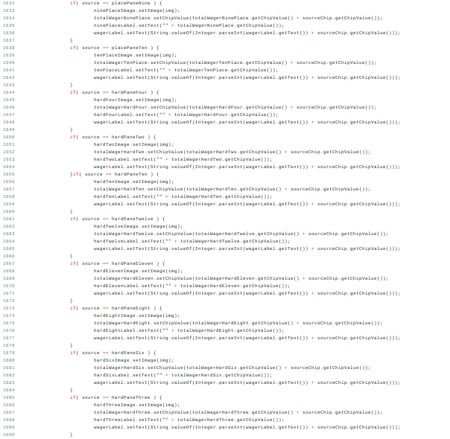
Project Code Explanation

Slide 32
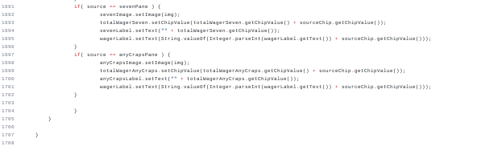
Project Code Explanation

Slide 33
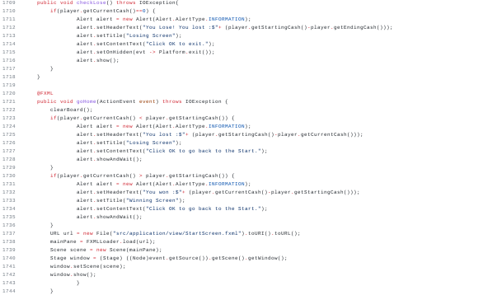
Project Code Explanation

Slide 34
Summary
Project Description/Pitch
Project Demo
Code Explanation
Summary

